Slide 1
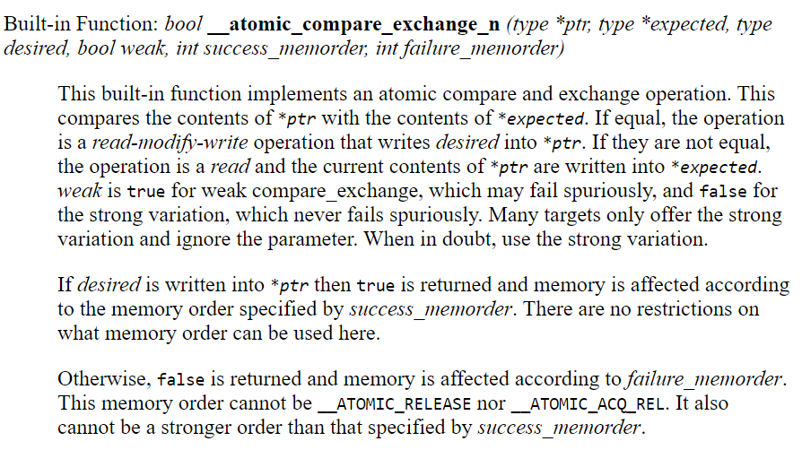
GCC atomic builtins
Shared
Mem loc
Private
(“your belief”)
In case
belief is right

